Slide 1




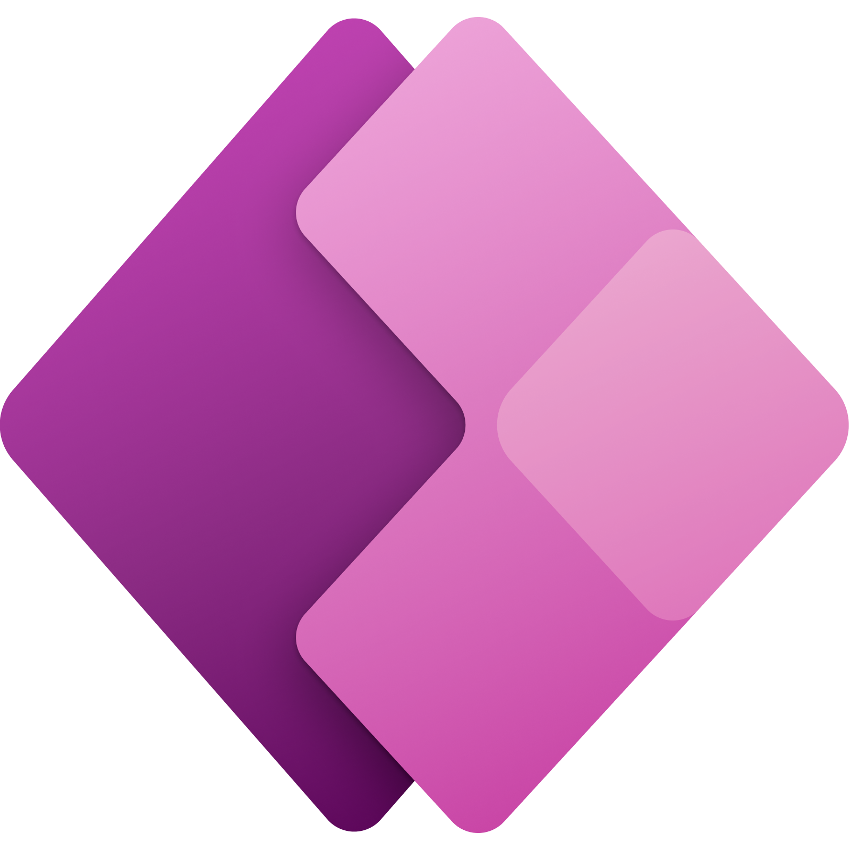








Microsoft Portfolio for AI
Applications
Partner Solutions
Business Users & Citizen Developers
Power Platform
Power BI
Power Apps
Power Automate
Power Virtual Agents
Azure AI
Scenario-Based Services
Applied AI Services
Bot Service
Cognitive Search
Form Recognizer
Video Analyzer
Metrics Advisor
Immersive Reader
Customizable AI Models
Cognitive Services
Developers & Data Scientists
Computer Vision
Speech Services
Language Understanding
Decision Engine
ML Platform
Azure Machine Learning
Notes:
here is the Azure AI portfolio.
Azure AI is a set of cloud services that are built upon Azure and deeply integrated with Azure’s Data, App Development, Compute services and tools. With this platform, we serve both hard-core developers and data scientists as well as business users and citizen developers.
Click (PaaS/SaaS) / Click (Integrated)
Starting from the bottom of the screen slide here..
With Azure Machine Learning, your developers & data scientists can build, train and deploy Machine Learning models.
Built using Azure Machine Learning, Cognitive Services – is the most comprehensive set of pre-trained, domain-specific models across Vision, Speech, Language and Decision making– which are all based on our breakthrough research conducted in Microsoft Research labs.
Click (Hybrid/Multi-cloud)
we are the only ones that can enable deployment anywhere – on-premises, on the edge and even other clouds through the use of containers.
And you can customize these models to meet your needs.
Finally, we offer AI scenario specific services for professional developers such as Bot Service, Cognitive Search, Form Recognizer, Video Analyzer. Others to mention are
Azure Bot Service is built on Azure Bot Framework, the most popular open source-based bot framework. you can build conversational experiences, often called conversational AI or bots, which can naturally interact with your users. Many conversational AI solutions were deployed during the pandemic, to deliver the slue of information gathered and developed on covid and getting that info out to citizens. Whether they were on an agencies or a hospital’s web site or thru call centers.
Video Analyzer. is used to extract in-depth metadata from video and audio content.
You may have Jan 6 capitol riot – video analyzer built on computer vision and speech services technologies were used to process video from thousands of videos taken by individuals on their phones and posted online. Technologies like that helped identify individual present at capitol during that time.
Knowledge Mining and Document intelligence solns can be built using Azure Cog Search and Form Recognizer
Azure Cognitive Search is the only cloud search service with built-in AI capabilities to create a unique solution for finding value in your data.
Form recognizer is designed to work on specific types of documents – forms. It extracts key value pairs from forms, thereby can help automate data entry tasks. Form recognizer is used by leading RPA providers such as UIPath as part of their solutions.
Finally - another unique aspect of our portfolio is our Power Platform, which is built on top of Azure AI and empowers citizen developers like business users and analysts, through low-code, point-and-click experiences.
Using this portfolio - we would recommend starting as high as possible and go as low as you need to.
Only Microsoft provides such a comprehensive set of capabilities for professional and citizen developer to harness the potential of AI – an enterprise grade secure and compliance set of services.
(click) Please also note they are FedRAMP high compliant in Azure commercial and government clouds.
And you has access to these services through your Microsoft Enterprise Agreement without any additional contracting necessary.
---------------------------------------
Azure AI is a set of AI services that are built upon Azure and deeply integrated with Azure’s Data, App Development, Compute services and tools.
With Azure Machine Learning, we provide developers data scientists and developers to build, train and deploy models.
AML is the only cloud ML service that enables developers of all skill levels to build ML models – from a code first experience, to drag & drop, to automated machine learning where developers are not required to have any ML knowledge. No matter how models are built, they are stored and managed in a central registry.
AML also provides advanced MLOPs capabilities with built-in integration with Azure DevOps. This enables developers to achieve model reproducibility, model validation, model deployment and model retraining capabilities.
Finally, AML is built on an open-source foundation. Developers can choose the Python tool and process of their choice and even get started on their laptops. They have the freedom to use MLflow if they’d like and take advantage of the ONNX Runtime to optimize inferencing on multiple HW targets.
Customizable Vision, Speech, Language & Decision Models:
Built with Azure Machine Learning, we also offer developers the most comprehensive set of domain-specific pre-trained models – 30 across Vision, Speech, Language and Decision making – which are all based on our breakthrough research. Not only does Azure AI have the most number of pre-trained models, we are the only ones that can enable deployment anywhere – on-premises, on the edge and even other clouds through the use of containers.
Scenario Specific Services
Finally, we offer AI applications specific services for professional developers.
Azure Bot Service is built on Azure Bot Framework, the most popular open source based bot framework.
This includes Azure Search is the only cloud app search service with built-in AI capabilities. This facilitates the creation of knowledge mining apps.
Form recognizer has been designed to work on specific types of documents – forms. It extracts key value pairs from forms, thereby automating data entry tasks. Form recognizer is used by leading RPA providers as part of their solutions.
Finally, we have Video Indexer. Video Indexer that is used to extract in-depth metadata from video and audio content.
Another aspect that makes us unique is our Power Platform, which is built on top of Azure AI and empowers citizen developers like business users and analysts, through low-code, point-and-click experiences.
Azure AI powers AI Builder, which serves AI capabilities to the rest of Power Platform. Citizen Developers can use Power Platform to:
Build custom AI applications that can predict customer churn, automatically route customer requests, and simplify inventory management through advanced image processing with PowerApps.
Automate tedious tasks such as invoice processing with Microsoft Automate.
Extract key phrases in documents, detect sentiment in content such as customer reviews, and build custom machine learning models in Power BI.
Build virtual agents in a no-code fashion.
Power Platform and Azure work well together. This enables companies to empower everyone in their organizations collaborate and build AI applications.
Only Microsoft provides such a comprehensive set of capabilities for professional and citizen developer to harness the potential of AI
1P: M365, D365, Power Platform, LinkedIn, Bing
3P: ISV, SI, customer implementation

Slide 2
Microsoft Portfolio for AI
Applications
Partner Solutions
Business Users & Citizen Developers
Power Platform
Power BI
Power Apps
Power Automate
Power Virtual Agents
Azure AI
Scenario-Based Services
Applied AI Services
Bot Service
Cognitive Search
Form Recognizer
Video Analyzer
Metrics Advisor
Immersive Reader
Customizable AI Models
Cognitive Services
Developers & Data Scientists
Computer Vision
Speech Services
Language Understanding
Decision Engine
ML Platform
Azure Machine Learning
Notes:
here is the Azure AI portfolio.
Azure AI is a set of cloud services that are built upon Azure and deeply integrated with Azure’s Data, App Development, Compute services and tools. With this platform, we serve both hard-core developers and data scientists as well as business users and citizen developers.
Click (PaaS/SaaS) / Click (Integrated)
Starting from the bottom of the screen slide here..
With Azure Machine Learning, your developers & data scientists can build, train and deploy Machine Learning models.
Built using Azure Machine Learning, Cognitive Services – is the most comprehensive set of pre-trained, domain-specific models across Vision, Speech, Language and Decision making– which are all based on our breakthrough research conducted in Microsoft Research labs.
Click (Hybrid/Multi-cloud)
we are the only ones that can enable deployment anywhere – on-premises, on the edge and even other clouds through the use of containers.
And you can customize these models to meet your needs.
Finally, we offer AI scenario specific services for professional developers such as Bot Service, Cognitive Search, Form Recognizer, Video Analyzer. Others to mention are
Azure Bot Service is built on Azure Bot Framework, the most popular open source-based bot framework. you can build conversational experiences, often called conversational AI or bots, which can naturally interact with your users. Many conversational AI solutions were deployed during the pandemic, to deliver the slue of information gathered and developed on covid and getting that info out to citizens. Whether they were on an agencies or a hospital’s web site or thru call centers.
Video Analyzer. is used to extract in-depth metadata from video and audio content.
You may have Jan 6 capitol riot – video analyzer built on computer vision and speech services technologies were used to process video from thousands of videos taken by individuals on their phones and posted online. Technologies like that helped identify individual present at capitol during that time.
Knowledge Mining and Document intelligence solns can be built using Azure Cog Search and Form Recognizer
Azure Cognitive Search is the only cloud search service with built-in AI capabilities to create a unique solution for finding value in your data.
Form recognizer is designed to work on specific types of documents – forms. It extracts key value pairs from forms, thereby can help automate data entry tasks. Form recognizer is used by leading RPA providers such as UIPath as part of their solutions.
Finally - another unique aspect of our portfolio is our Power Platform, which is built on top of Azure AI and empowers citizen developers like business users and analysts, through low-code, point-and-click experiences.
Using this portfolio - we would recommend starting as high as possible and go as low as you need to.
Only Microsoft provides such a comprehensive set of capabilities for professional and citizen developer to harness the potential of AI – an enterprise grade secure and compliance set of services.
(click) Please also note they are FedRAMP high compliant in Azure commercial and government clouds.
And you has access to these services through your Microsoft Enterprise Agreement without any additional contracting necessary.
---------------------------------------
Azure AI is a set of AI services that are built upon Azure and deeply integrated with Azure’s Data, App Development, Compute services and tools.
With Azure Machine Learning, we provide developers data scientists and developers to build, train and deploy models.
AML is the only cloud ML service that enables developers of all skill levels to build ML models – from a code first experience, to drag & drop, to automated machine learning where developers are not required to have any ML knowledge. No matter how models are built, they are stored and managed in a central registry.
AML also provides advanced MLOPs capabilities with built-in integration with Azure DevOps. This enables developers to achieve model reproducibility, model validation, model deployment and model retraining capabilities.
Finally, AML is built on an open-source foundation. Developers can choose the Python tool and process of their choice and even get started on their laptops. They have the freedom to use MLflow if they’d like and take advantage of the ONNX Runtime to optimize inferencing on multiple HW targets.
Customizable Vision, Speech, Language & Decision Models:
Built with Azure Machine Learning, we also offer developers the most comprehensive set of domain-specific pre-trained models – 30 across Vision, Speech, Language and Decision making – which are all based on our breakthrough research. Not only does Azure AI have the most number of pre-trained models, we are the only ones that can enable deployment anywhere – on-premises, on the edge and even other clouds through the use of containers.
Scenario Specific Services
Finally, we offer AI applications specific services for professional developers.
Azure Bot Service is built on Azure Bot Framework, the most popular open source based bot framework.
This includes Azure Search is the only cloud app search service with built-in AI capabilities. This facilitates the creation of knowledge mining apps.
Form recognizer has been designed to work on specific types of documents – forms. It extracts key value pairs from forms, thereby automating data entry tasks. Form recognizer is used by leading RPA providers as part of their solutions.
Finally, we have Video Indexer. Video Indexer that is used to extract in-depth metadata from video and audio content.
Another aspect that makes us unique is our Power Platform, which is built on top of Azure AI and empowers citizen developers like business users and analysts, through low-code, point-and-click experiences.
Azure AI powers AI Builder, which serves AI capabilities to the rest of Power Platform. Citizen Developers can use Power Platform to:
Build custom AI applications that can predict customer churn, automatically route customer requests, and simplify inventory management through advanced image processing with PowerApps.
Automate tedious tasks such as invoice processing with Microsoft Automate.
Extract key phrases in documents, detect sentiment in content such as customer reviews, and build custom machine learning models in Power BI.
Build virtual agents in a no-code fashion.
Power Platform and Azure work well together. This enables companies to empower everyone in their organizations collaborate and build AI applications.
Only Microsoft provides such a comprehensive set of capabilities for professional and citizen developer to harness the potential of AI
1P: M365, D365, Power Platform, LinkedIn, Bing
3P: ISV, SI, customer implementation

Slide 3









Slide 4




Databases | Analytics | Data Governance
Azure SQL family SQL Server on Azure Virtual Machines Azure SQL Managed Instance Azure SQL Database Azure SQL Edge
Azure SQL Managed Instance

Slide 5

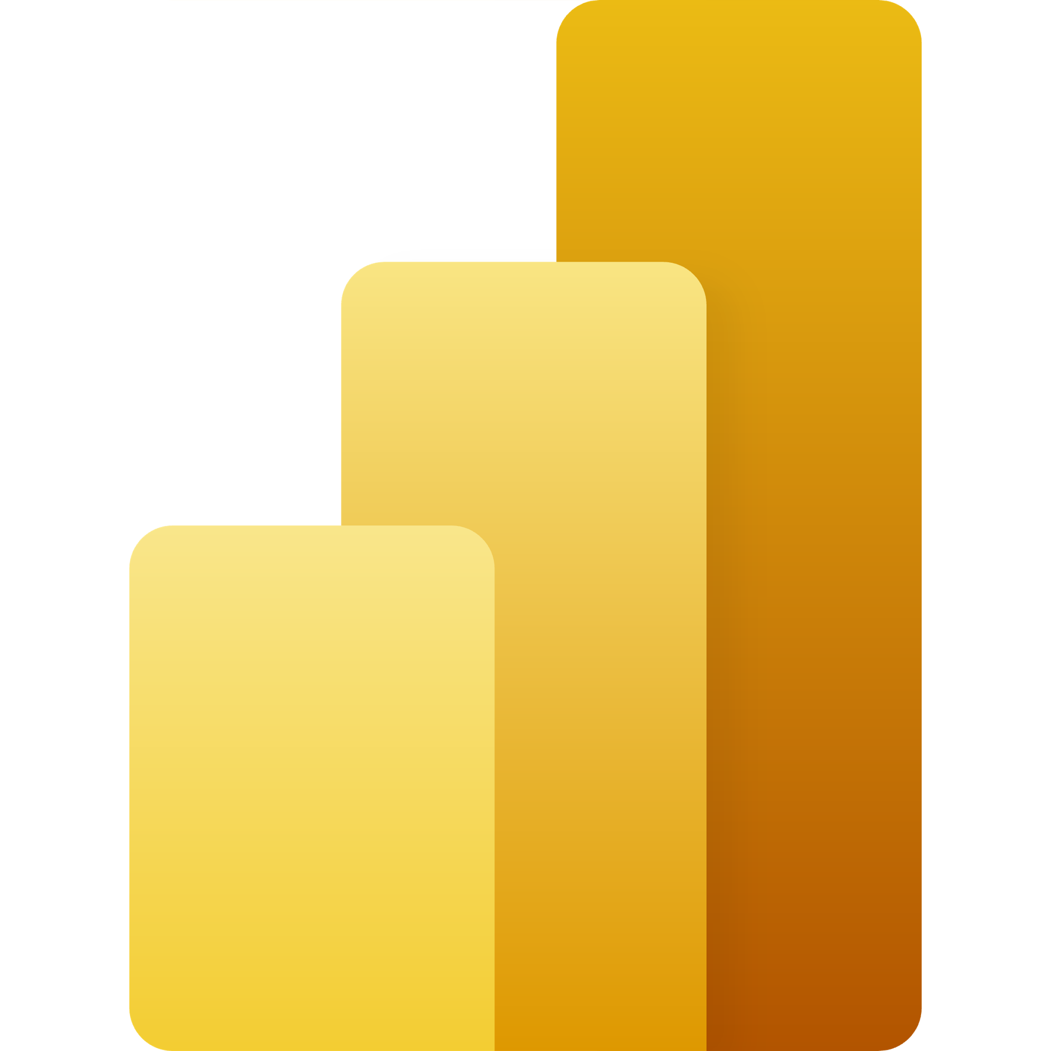


Microsoft Intelligent Data Platform
Azure SQL
Azure Synapse Analytics
Azure Cosmos DB
Azure Machine Learning
SQL Server 2022
Power BI
Azure Arc Hybrid and multicloud
Microsoft Purview

Slide 6
Microsoft Intelligent Data Platform
Azure SQL
Azure Cosmos DB
SQL Server 2022
Azure Arc
Azure Synapse Analytics
Power BI
Azure Machine Learning
Microsoft Purview

Slide 7

















Analytics
Data Engineering |  | Analytics
Ingest | Store | Enrich, Explore, Discover | Publish
Data Governance
2
3
4
1
Event Hubs
Relational databases
AI / ML and Applied AI
Power BI
IoT Hub
Key/value stores
Synapse Analytics
Azure Data Share
Data Factory
Document databases
Azure Databricks
Synapse Analytics
Graph databases
Data Explorer
Machine Learning
Data analytics
HDInsight
Data Explorer
Column-family databases
Data Lake Analytics
Search engine databases
Analysis Services
Time series databases
Object storage
Shared files
Microsoft Purview
5

Slide 8
Analytics Simplified
Data Engineering |  | Analytics
Ingest | Store | Enrich, Explore, Discover | Publish
Data Governance
2
3
4
1
Synapse Analytics
Power BI
Microsoft Purview
5

Slide 9
Analytics Continuum
Foresight
Value
Prescriptive
Insight
Hindsight
Predictive
Diagnostic
Descriptive
Complexity
Four Types of Data Analytics (Adapted from Gartner 2012)

Slide 11



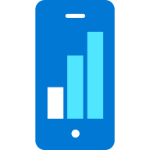

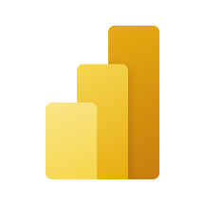

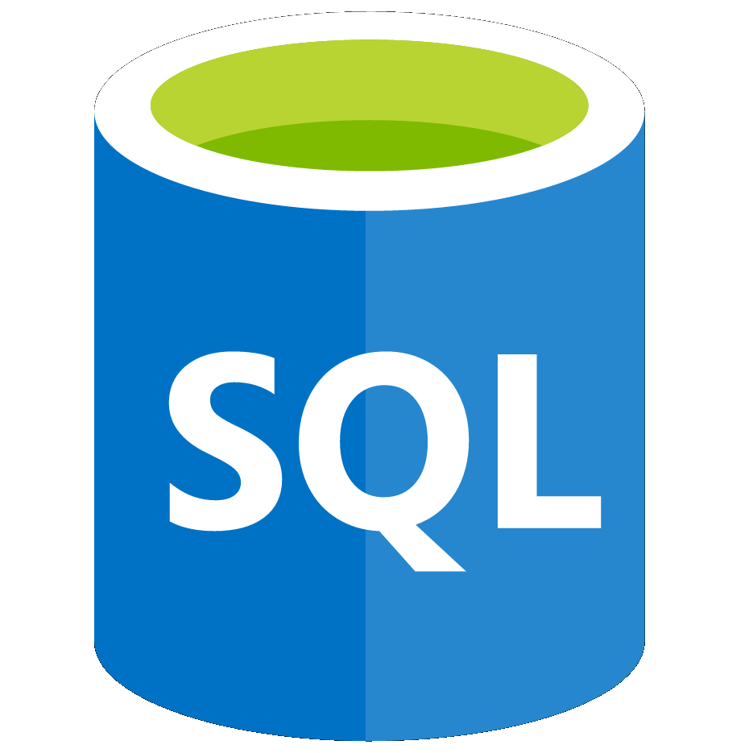



Azure Synapse Analytics
cloud-native analytics platform
Designed for analytics workloads at any scale
SaaS developer experiences for code free and code first
Multiple languages suited to different analytics workloads
Integrated analytics runtimes available dedicated and serverless on-demand
SQL Analytics offering T-SQL for batch, streaming and interactive processing
Spark for big data processing with Python, Scala, R and .NET
Integrated platform services for, management, security, monitoring, and metastore
Data lake integrated and Common Data Model aware
On-prem data
Azure Synapse Studio
Azure
Data Share
Integration
Database Templates
Management
Monitoring
Security
DevOps
Cloud data
Analytic runtimes
Azure
Machine Learning
SQL
Data Explorer
SaaS data
Semantic Layer – Common Data Model
Data Warehouse
Data Lake
Event Brokers
Azure Synapse Link
Power BI
Streaming data
Cosmos DB
Dataverse
Power Apps
Azure
Purview
Notes:
Azure Synapse unifies your data, your data tasks, and your data teams with a limitless analytics service that does it all. This is the result of a multi-year effort.
We set out to rearchitect and create the next generation of query processing and data management with Synapse to meet the needs of the modern, high scale, volume, velocity, and variety of data workloads.
As these modern workloads require both SQL and Apache Spark, we saw that customers would need a cloud-native analytics service engine that converged big data and data warehousing so they could achieve limitless scale on structured, semi-structured, and un-structured data.
Kim

Slide 12
SQL Server on Azure VMs
Azure SQL Managed Instance
Azure SQL Database
Azure SQL Edge

